Slide 1
ITI Graduation Project

Slide 2
Automated Application Deployment

Slide 3
Our Team
Alaa Mohamed Abdel Hamid Gomaa
Alaa Walid El-Shitany
Nada Khater Abdu
Hebatullah Adel AbdElgaber
Lina Ahmed El Duhemy

Slide 4
Table of contents
01.
02.
03.
Install Local K8s Instance
Namespace Configuration
Tool Deployment
04.
05.
06.
Application Deployment
Jenkins Pipeline for Docker
Deployment Pipeline
Used Minikube and Ansible for local setup
Created 'tools' and 'dev' namespaces with Terraform.
Deployed Jenkins & Nexus in 'tools' namespace by Terraform.
Deployed Node.js and MySQL pods in 'dev' namespace.
Automates code checkout, build, Docker image creation, and upload to Nexus.
Pulls Docker image from Nexus and runs on Minikube

Slide 5
01.
Install Local K8s Instance

Slide 6
Tools used
Minikube
Ansible
Sets up a single-node Kubernetes cluster locally.
Ideal for development and testing.
Supports multiple virtualization technologies (e.g., Docker, VirtualBox).
Open-source automation tool.
Uses human-readable YAML for configurations.

Slide 7
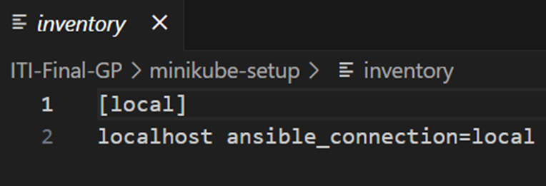
Inventory File
A configuration file in Ansible used to define and organize the hosts / machines that Ansible will manage.
Define a host (localhost) in the [local] group for local execution.

Slide 8
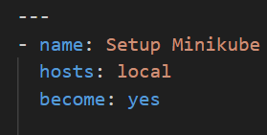
Playbook Metadata
name: Setup Minikube
hosts: local
Specifies that the tasks will run on the localhost.
become: yes
Enables privilege escalation for tasks that require root access.

Slide 9
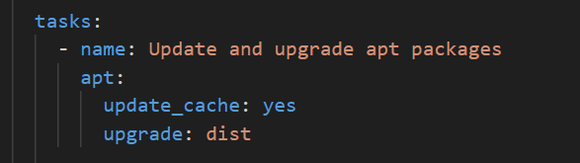
1. Update and upgrade apt packages
apt:
update_cache: yes
Updates the apt package cache before installation.
upgrade: dist
Upgrades all installed packages to their latest versions.

Slide 10
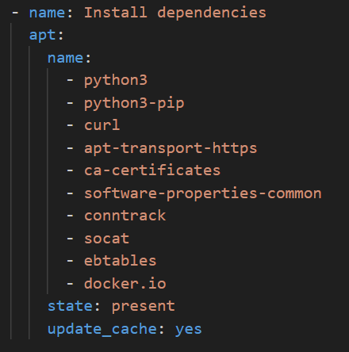
2. Install dependencies
List of packages to be installed for Minikube and K8s:
python3: Python 3 interpreter.
python3-pip: Python package installer for Python 3.
curl: Tool for transferring data with URLs.
ca-certificates: CA certificates for validating SSL connections.
conntrack: Tool for tracking network connections.
docker.io: Docker engine for container management.
state: present
Ensures the packages are installed.

Slide 11
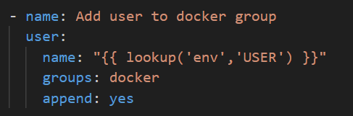
3. Add user to docker group
Allows running Docker commands without sudo.
user:
name: "{{ lookup('env','USER') }}“
Dynamically retrieves the current user name from the environment variables
groups: docker
Adds the user to the 'docker' group.
append: yes
Ensures the user is appended to the Docker group without removing existing group memberships..

Slide 12
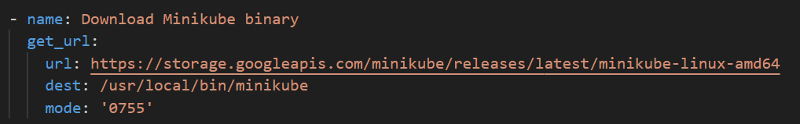
4. Download Minikube binary
Fetches the latest Minikube binary and saves it to /usr/local/bin
get_url:
url:
URL to download the Minikube binary.
dest: /usr/local/bin/minikube
Destination path on the local machine.
mode: '0755'
Sets executable permissions on the downloaded file.

Slide 13
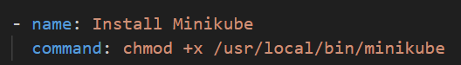
5. Install Minikube
Command: chmod +x /usr/local/bin/minikube
Changes permissions to make the Minikube binary executable.

Slide 14
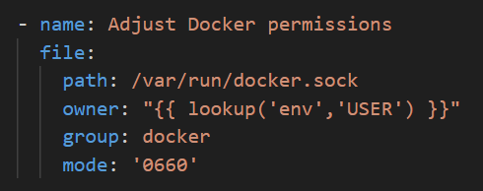
6. Adjust Docker permissions
Ensures the current user can access the Docker socket.
file:
path: : /var/run/docker.sock
Path to the Docker socket file which
Allows processes and applications to communicate with the Docker daemon locally

Slide 15
6. Adjust Docker permissions cont’d
owner : "{{ lookup('env','USER') }}“
Sets the owner of the Docker socket to the current user.
group : docker
Sets the group of the Docker socket to 'docker’.
mode : 0660
Sets read and write permissions for both user and group.

Slide 16
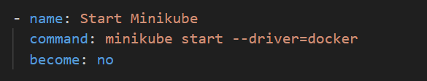
7. Start Minikube
command: minikube start --driver=docker
Starts Minikube using the Docker driver. So. Minikube will set up and manage Kubernetes nodes using Docker containers.
become: no
Disables privilege escalation for this command.

Slide 17
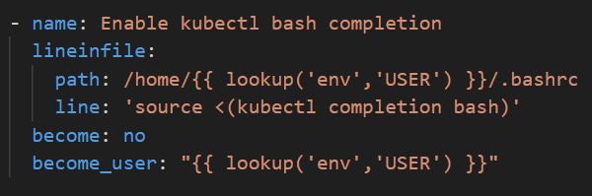
8. Enable kubectl bash completion
Adds the necessary configuration to the .bashrc file.
lineinfile:
path: /home/{{ lookup('env','USER') }}/.bashrc
Path to the user's bashrc file.
line: 'source <(kubectl completion bash)'
It configures bash completion for kubectl.
Bash completion enhances the user experience by providing autocomplete suggestions when typing kubectl commands in the terminal.

Slide 18
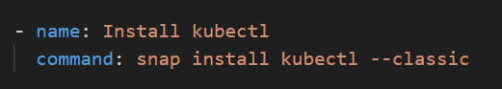
9. Install kubectl
Installs kubectl via the Snap package manager

Slide 19
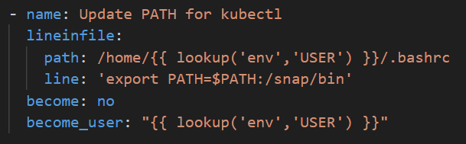
10. Update Path for kubectl
Ensures kubectl is accessible from the command line by updating the PATH environment variable to include the Snap bin directory
lineinfile:
path: Path to the user's bashrc file.
line: 'export PATH=$PATH:/snap/bin'
Adds Snap bin directory to PATH.

Slide 20
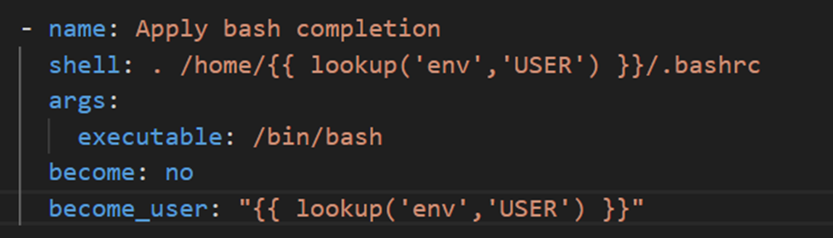
11. Apply bash completion
Apply the bash completion configuration immediately by sourcing the updated .bashrc file.
shell: . /home/{{ lookup('env','USER') }}/.bashrc
Runs the command, Sourcing the .bashrc file ensures that any changes made to it are applied immediately to the current shell session.
args:
executable: /bin/bash
Specifies the shell to execute the command.

Slide 21
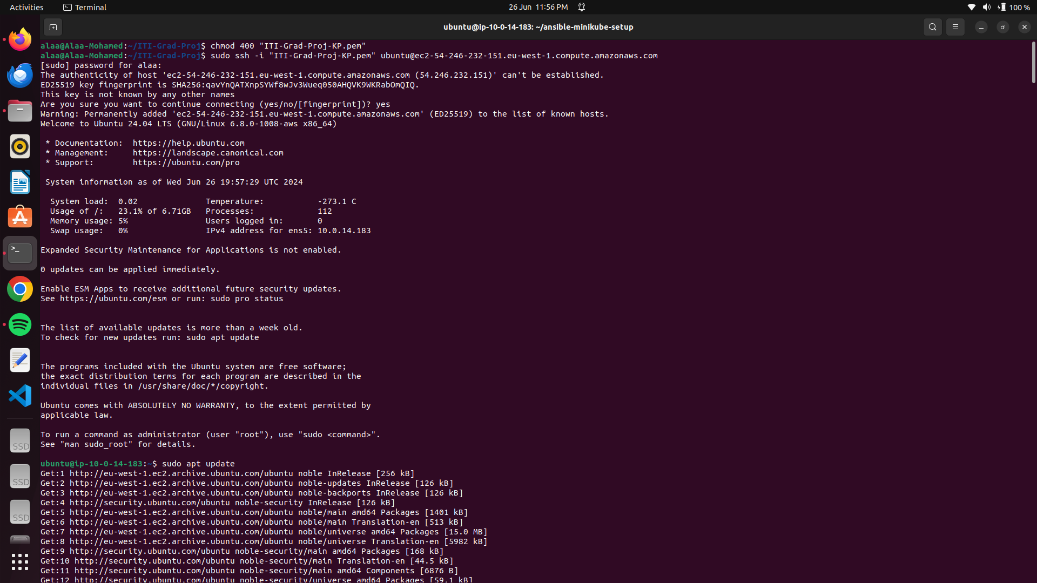
Steps

Slide 22
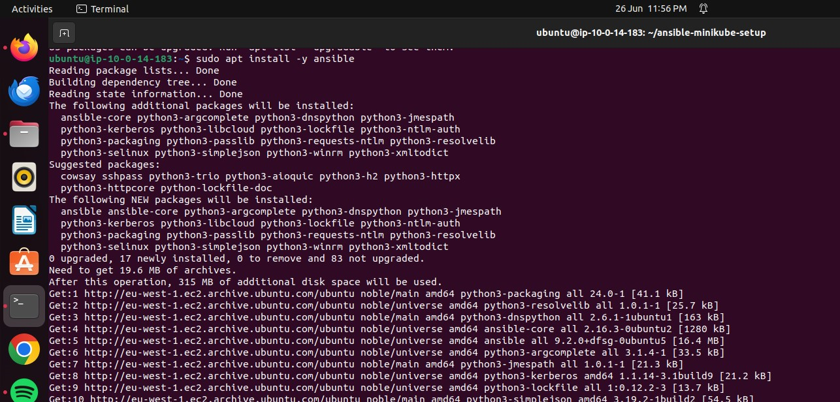

Slide 23
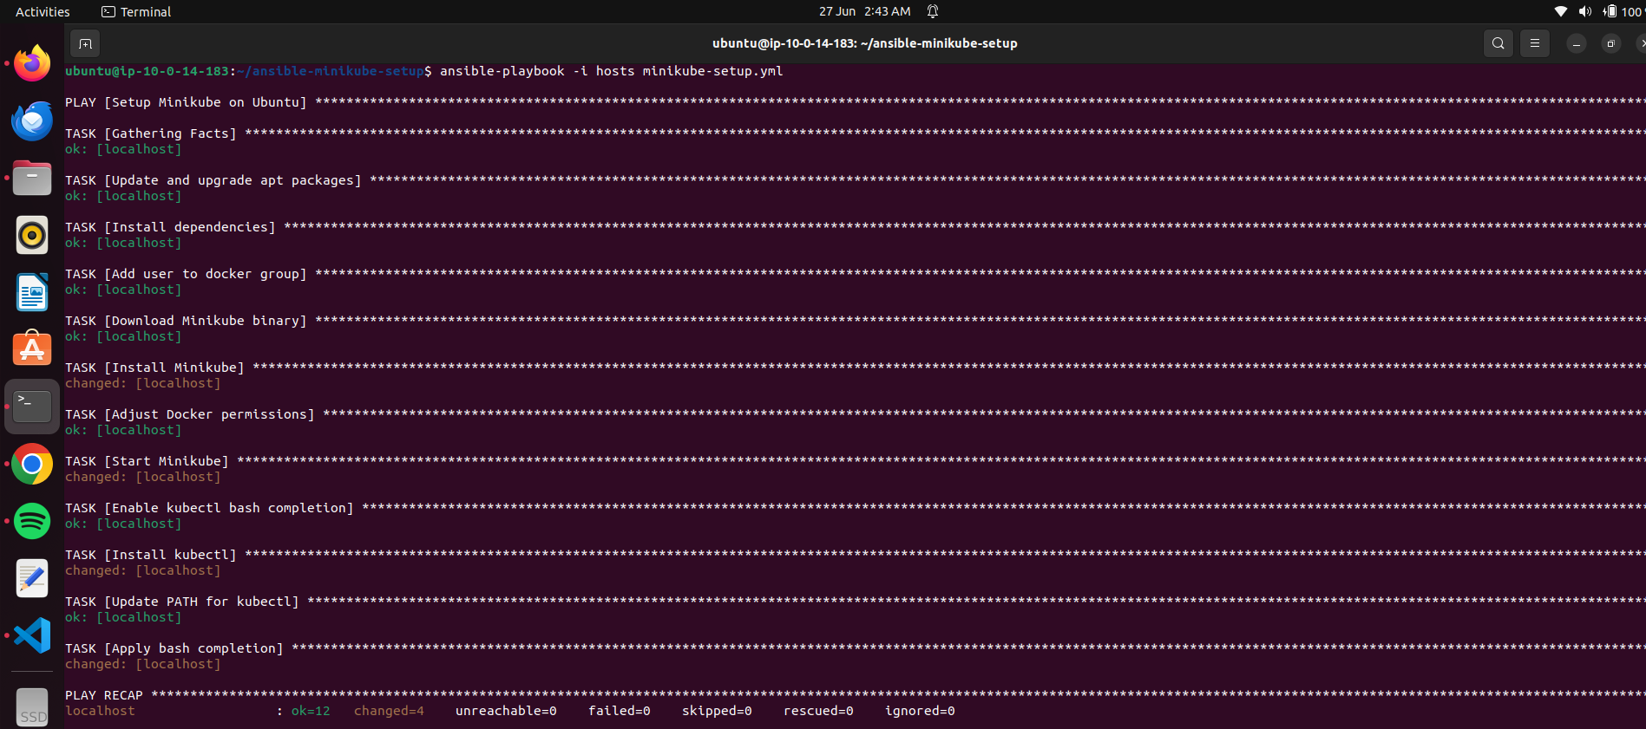

Slide 24
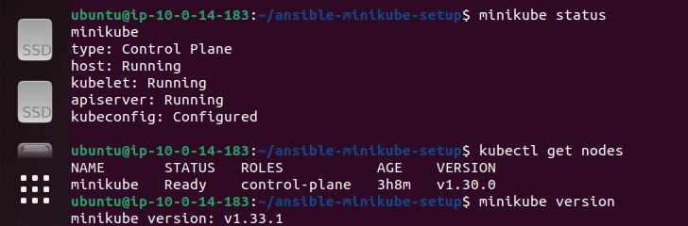
Results

Slide 25
02
Namespace Configuration

Slide 26
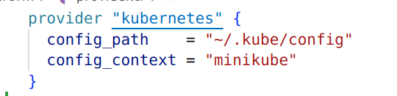
1. Provider

Slide 27
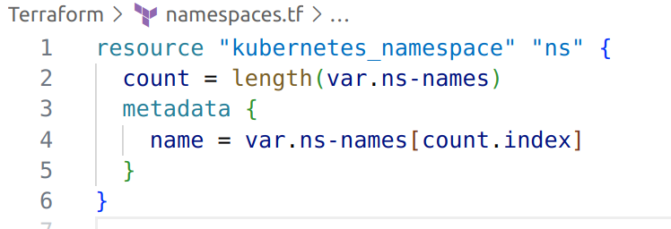
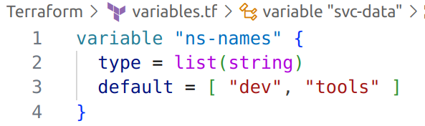
2. Name Space
Define namespace resource.
Count & vars to make code more generic.

Slide 28
03
Tool Deployment

Slide 29
Tools Namespace
Jenkins as CI/CD tool.
Nexus as a Repository Manager.

Slide 30
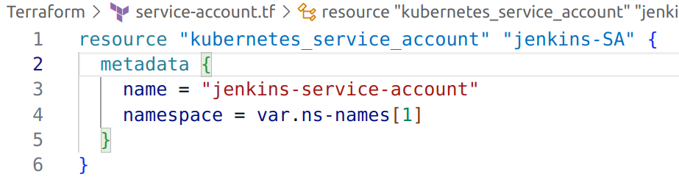
1. Service Account
Service account provides an identity for processes that run in a Pod, and maps to a service account object.

Slide 31
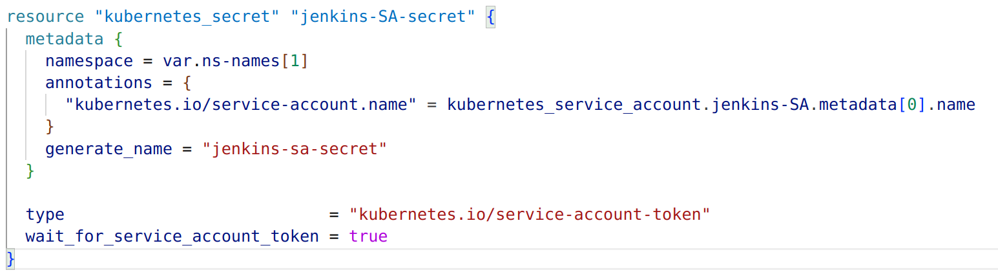
2. Service Account Secret
Service account Secret creates a secret that holds the token for the service account.

Slide 32
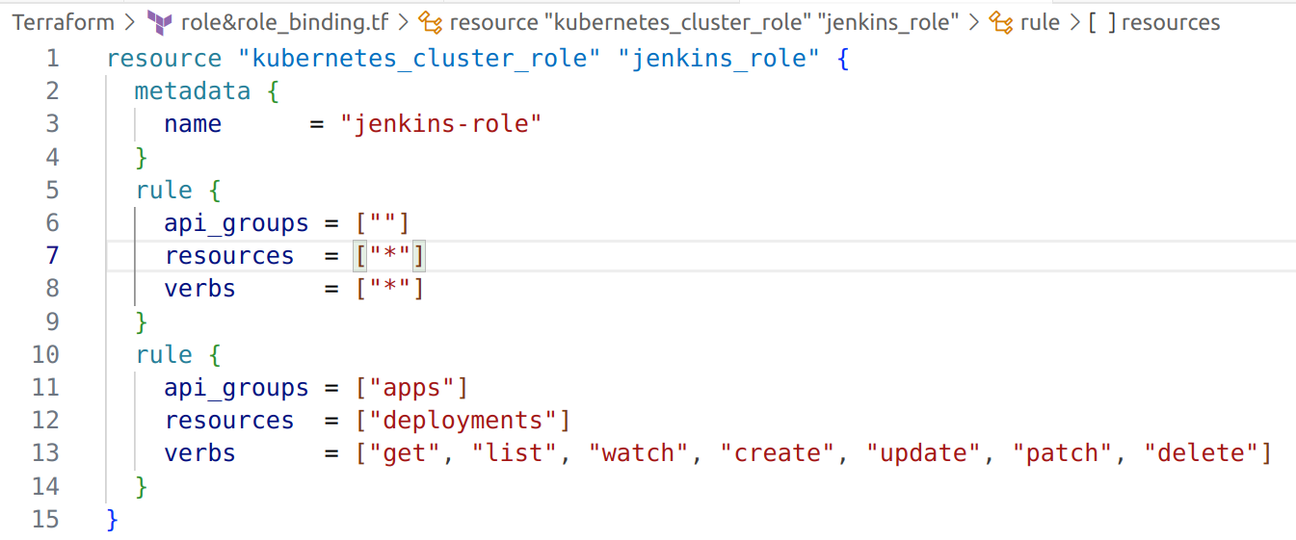
3. Cluster Role
ClusterRole in Kubernetes is a way to grant broad permissions to resources across the entire cluster.

Slide 33
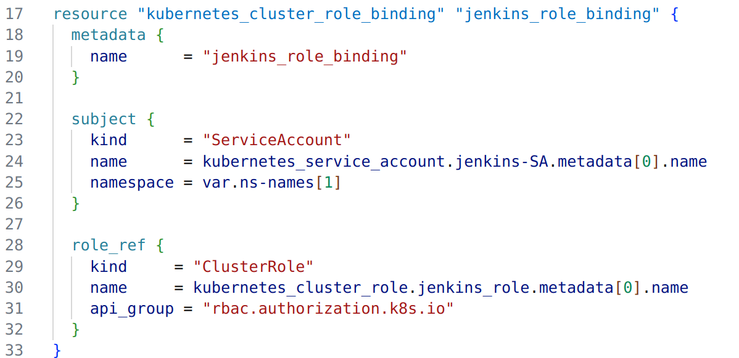
4. Cluster Role Binding
ClusterRoleBinding ensures that the Jenkins service account has these permissions across the entire cluster.

Slide 34
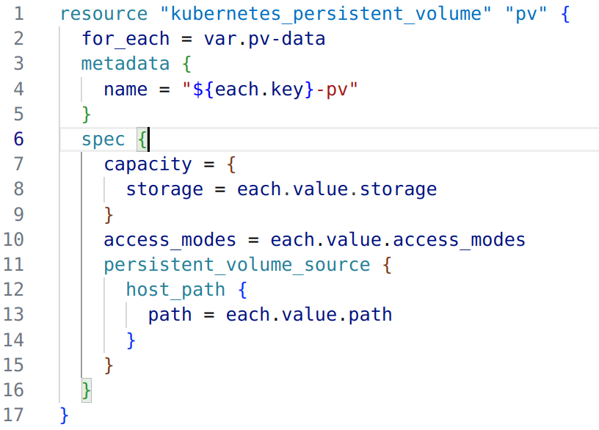
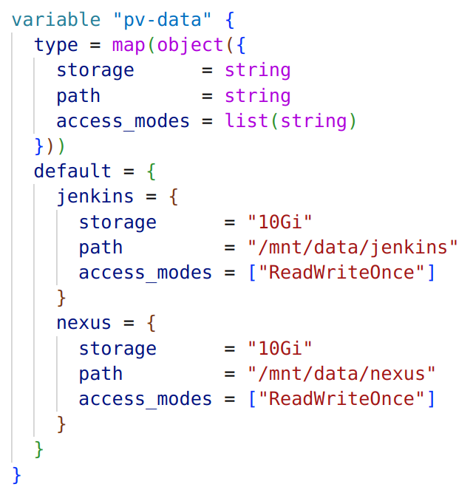
5. Persistent Volume
Persistent Volumes (PVs) in Kubernetes are storage resources that exist independently of any Pod and retain data across Pod restarts

Slide 35
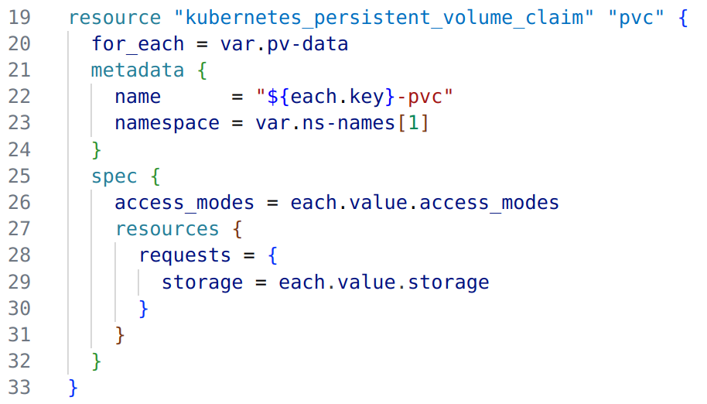
6. Persistent Volume Claim
Persistent Volume Claims (PVCs) are requests for storage by users (applications, Pods) in Kubernetes.

Slide 36
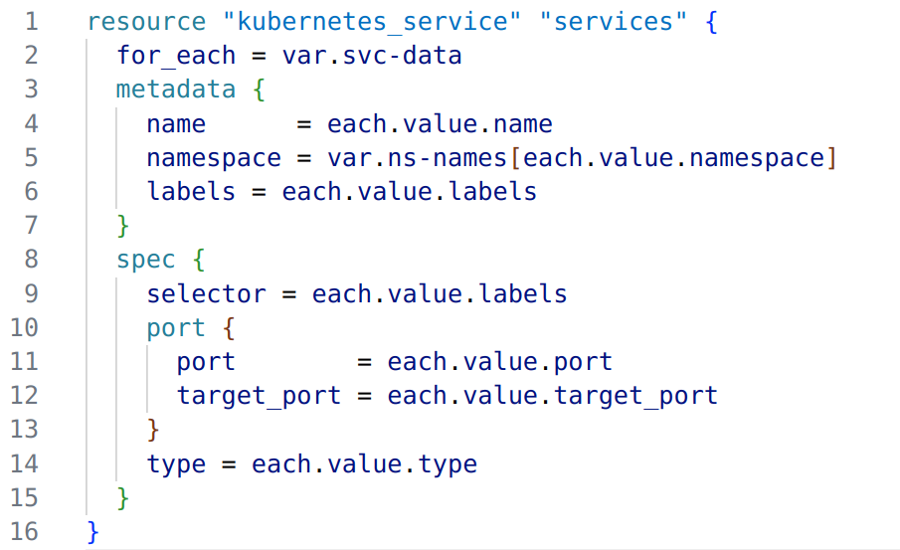
6. Services
The service in Kubernetes is used to expose applications running in Kubernetes Pods to other services within the cluster or to external clients.

Slide 37
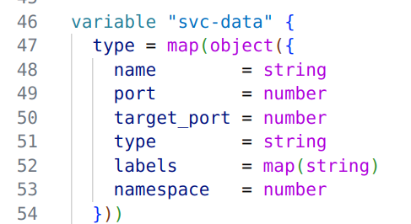
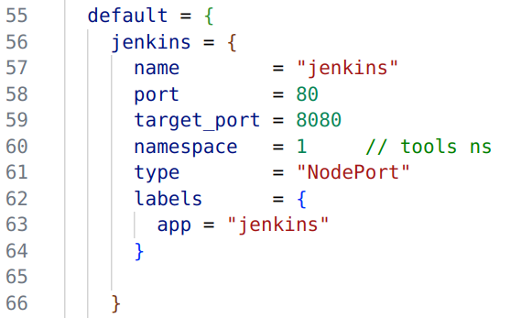
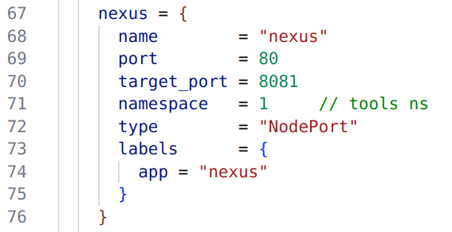

Slide 38
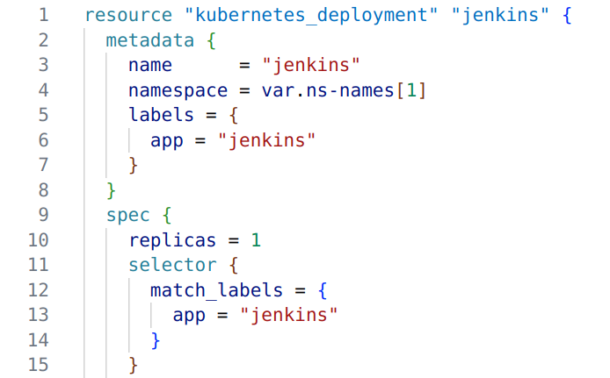
7. Deployments

Slide 39
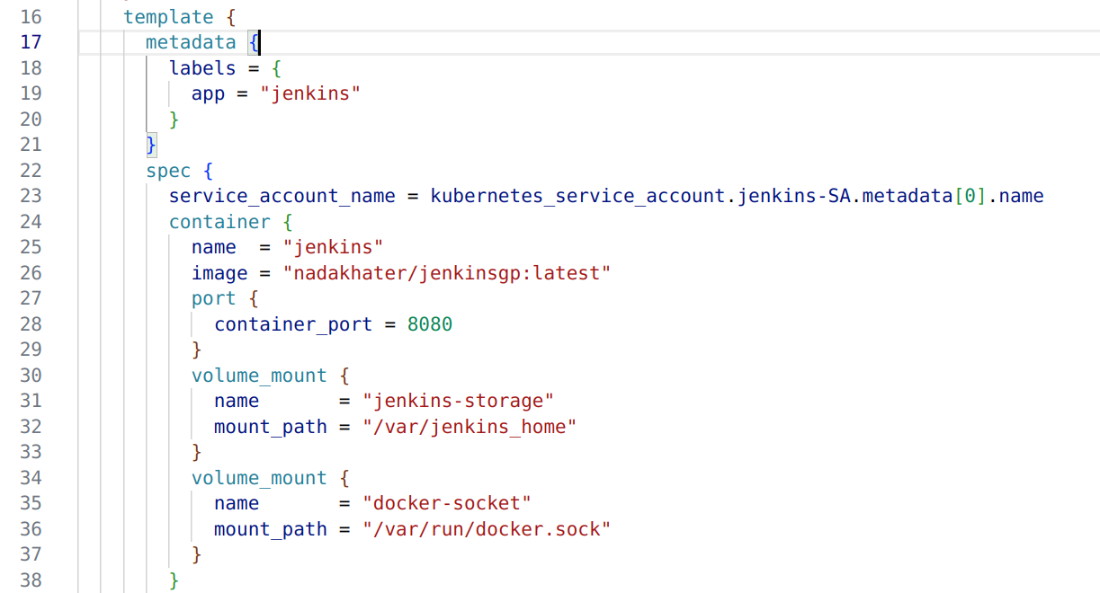
7. Deployments

Slide 40
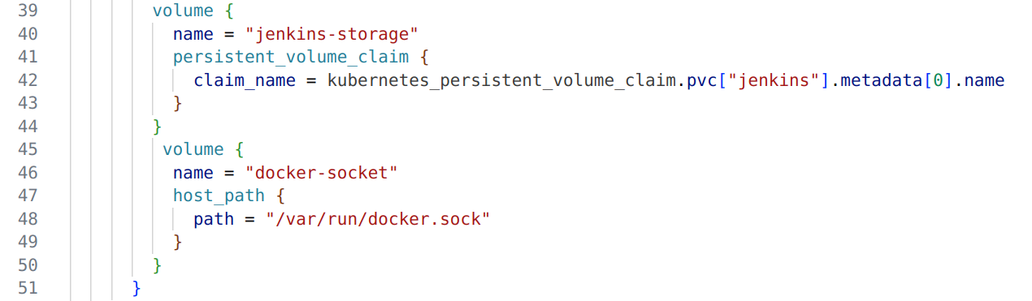
7. Deployments

Slide 41
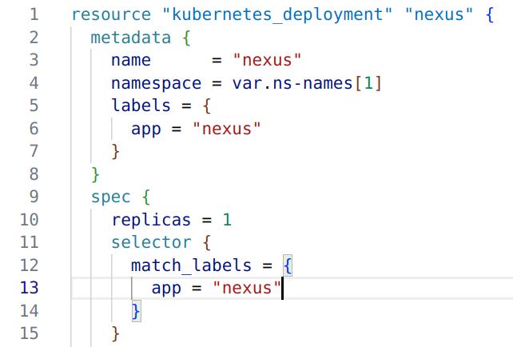
7. Deployments

Slide 42
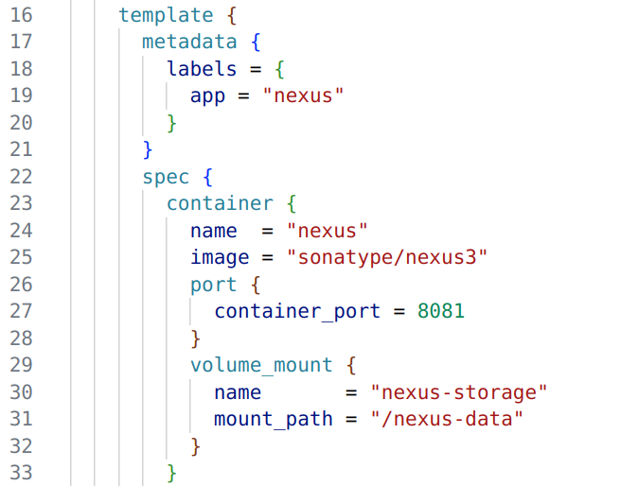
7. Deployments

Slide 43
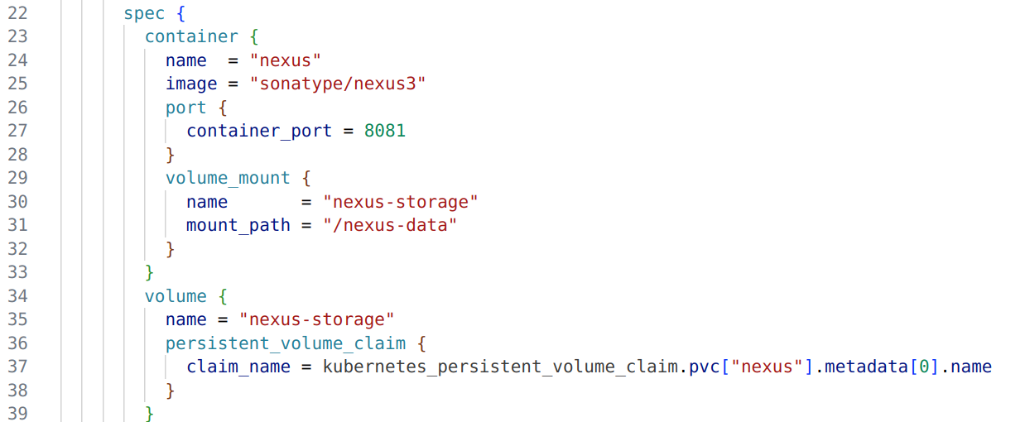
7. Deployments

Slide 44
04
Application Deployment

Slide 45
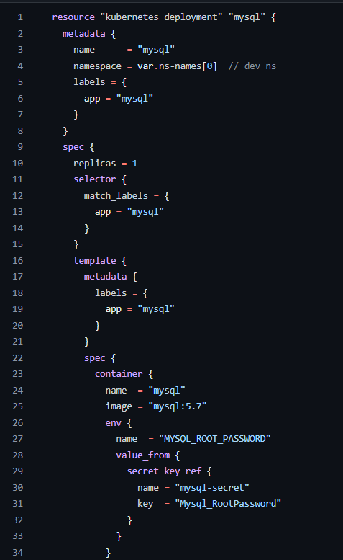
1. MySQL Deployment in dev
Define k8s Deployment for MySQL in `dev` namespace.
Deployment Specifications:
Name: mysql
Namespace: dev
Labels: app = mysql
Container:
Image: mysql:5.7
Environment Variables: MySQL credentials from k8s secrets

Slide 46
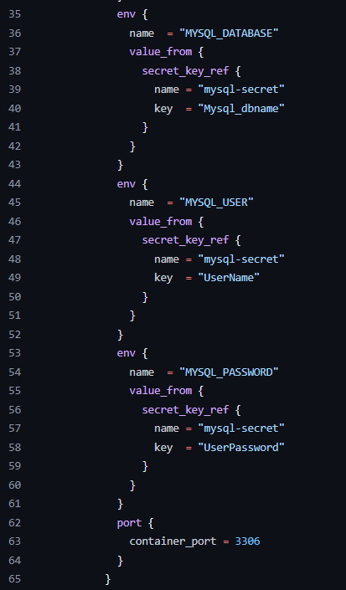
1. MySQL Deployment in dev (cont.d)
Environment Variables:
Sets MySQL environment variables using secrets.

Slide 47
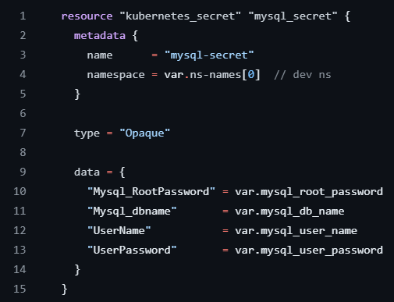
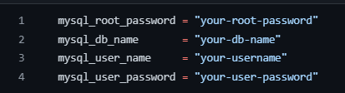
2. Create K8S Secret for MySQL
Create a K8s Secret to store sensitive information such as MySQL passwords and usernames.
Resource Specifications:
Type: Specifies the secret type as Opaque (store any key-value pairs).

Slide 48
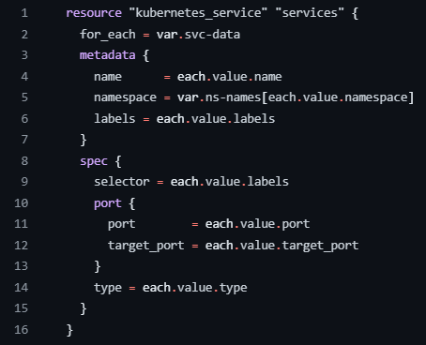
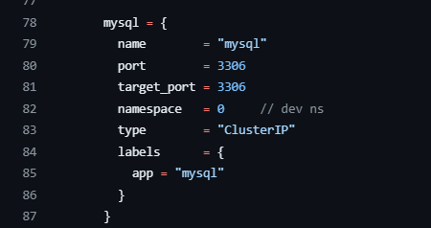
3. Create Service for MySQL
Create K8s service for MySQL to configure the necessary ports, selectors, and service types.
Resource Specifications:
MySQL Service:
Name: mysql
Port: 3306
Target Port: 3306
Type: ClusterIP

Slide 49
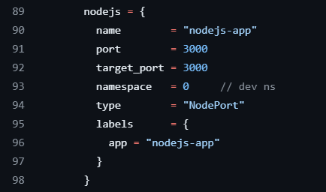
4. Create Service for Node js app
Create K8s service for Nodejs app to configure the necessary ports, selectors, and service types.
Resource Specifications:
Node.js Service:
Name: nodejs-app
Port: 3000
Target Port: 3000
Type: NodePort

Slide 50
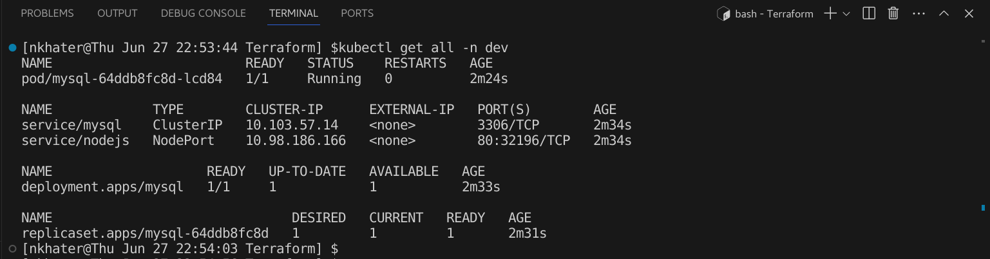
5. Results
Check all resources in `dev` namespace.
Successfully created mysql pod, service for both mysql and Nodejs app.

Slide 51
05
Jenkins Pipeline for Docker

Slide 52
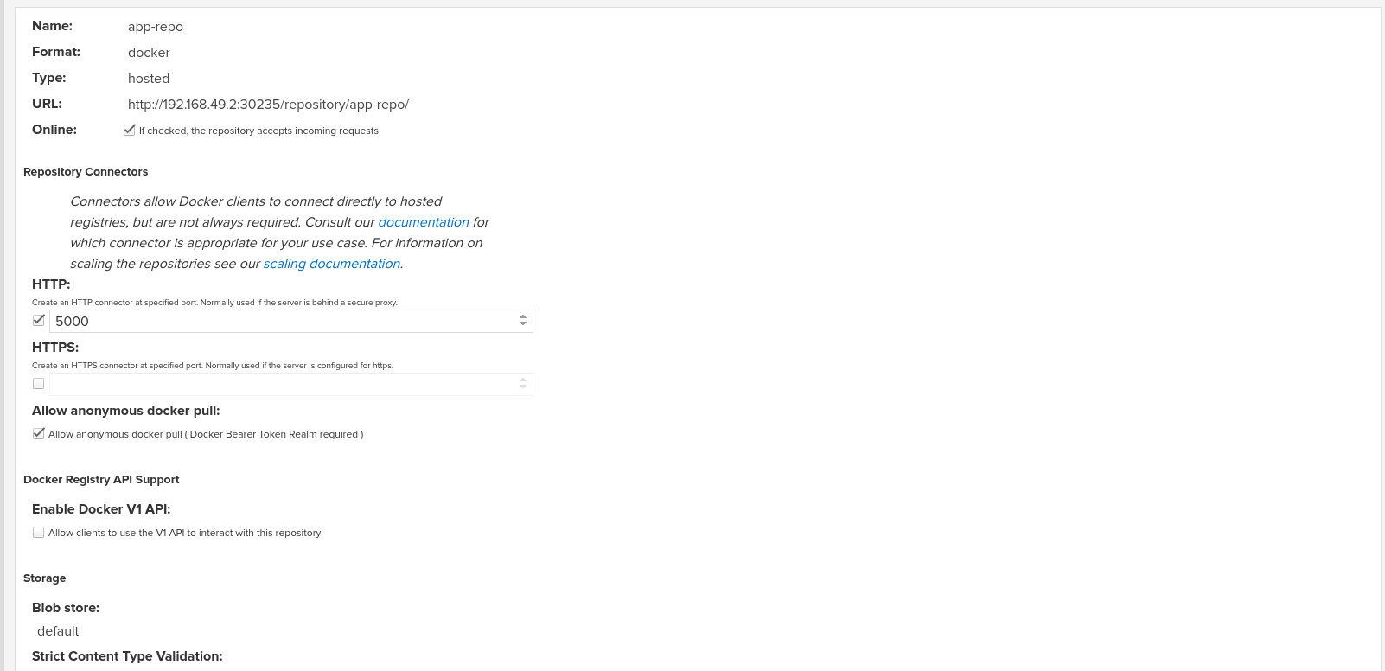
create nexus repo

Slide 53
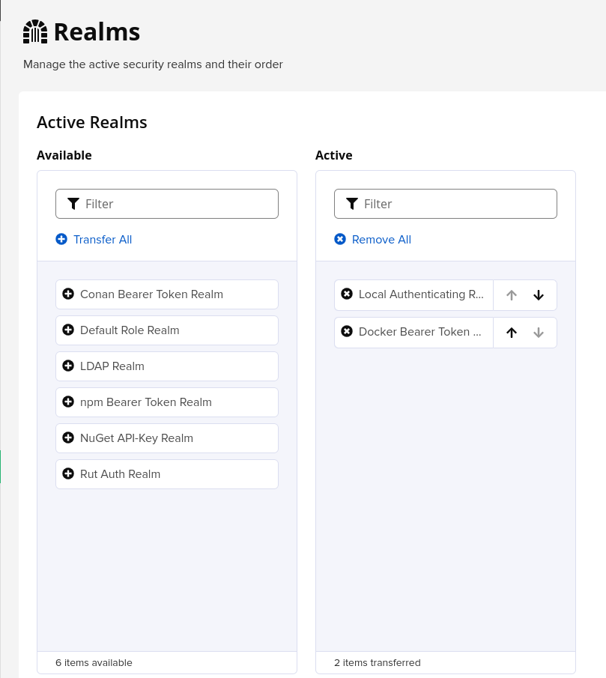
Activate "Docker Bearer Token Realm" in realms

Slide 54
Checkout code from github repo
Create a Docker image
Build nodejs app using dockerfile
Upload Docker image to nexus

Slide 55
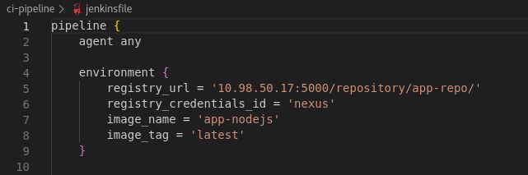

Slide 56
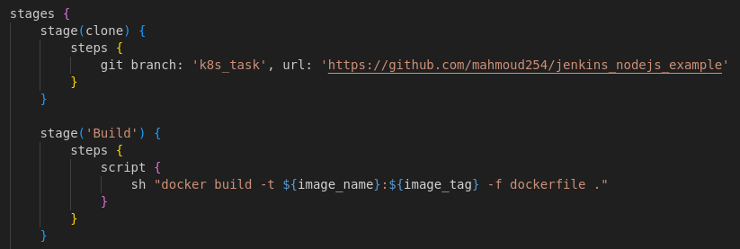

Slide 57
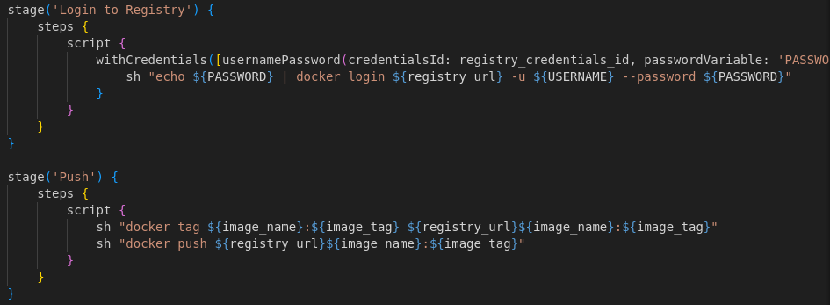
Activate "Docker Bearer Token Realm" in realms,

Slide 58


After successfully running to pipeline

Slide 59
04
Deployment pipeline

Slide 60


Create deployment in namespace dev.
matchLabels with the Nodejs app service.

Slide 61


Create container of the image pushed before on nexus with port 3000.

Slide 62


Set the Environment Variables to be able to connect with the Mysql .

Slide 63


Slide 64
By the created resources of Service_Account, Cluster role & role_binding, jenkins of namespace tools have the role to create resources on the namespace dev.
To apply the deployment.yaml => Create CD pipeline

Slide 65

We need to install kubectl to able to run commands:

Slide 66

Clone our project repo
Specify the path of deployment file.
apply

Slide 67


Slide 68


Final result

Slide 69

Final result

Slide 70
Thank you!

